Slide 1
Yes to AMEX!
-Mission Gen Y

Slide 2
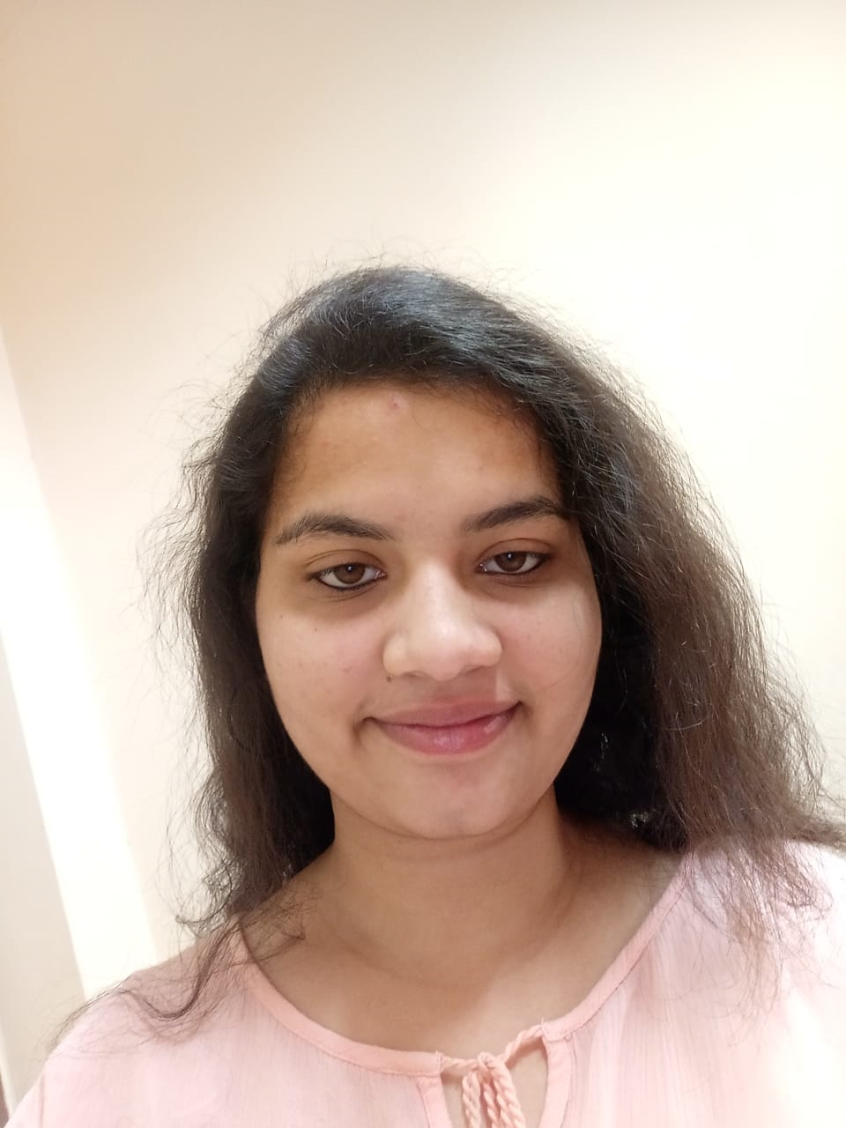
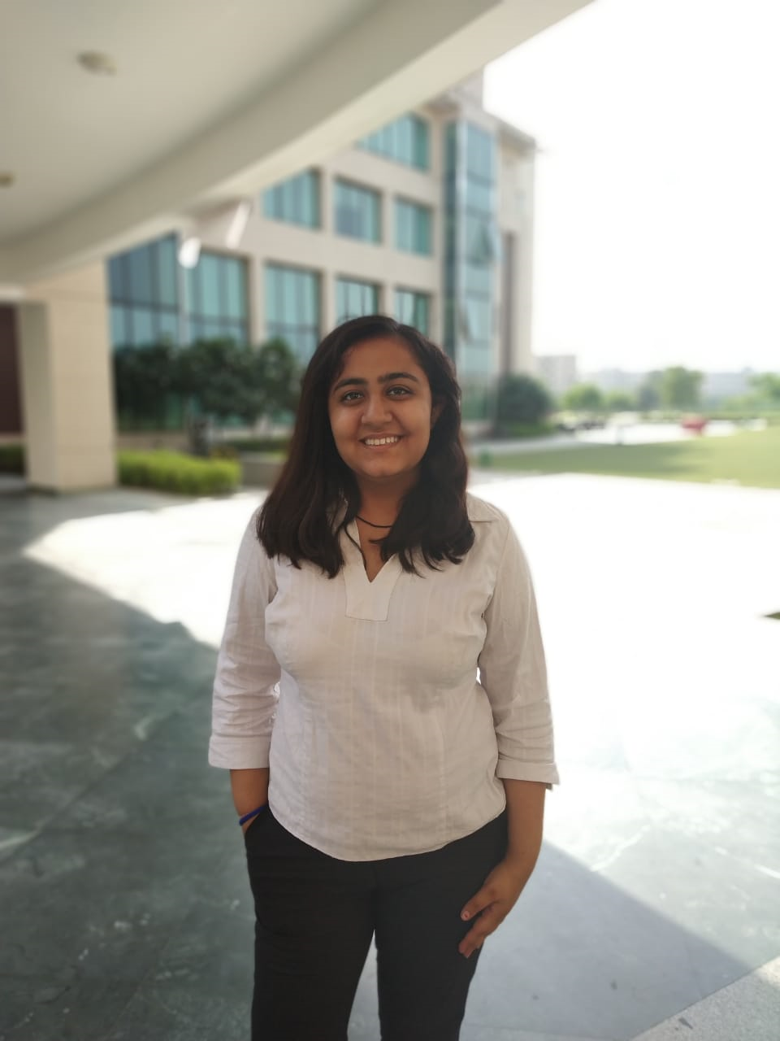

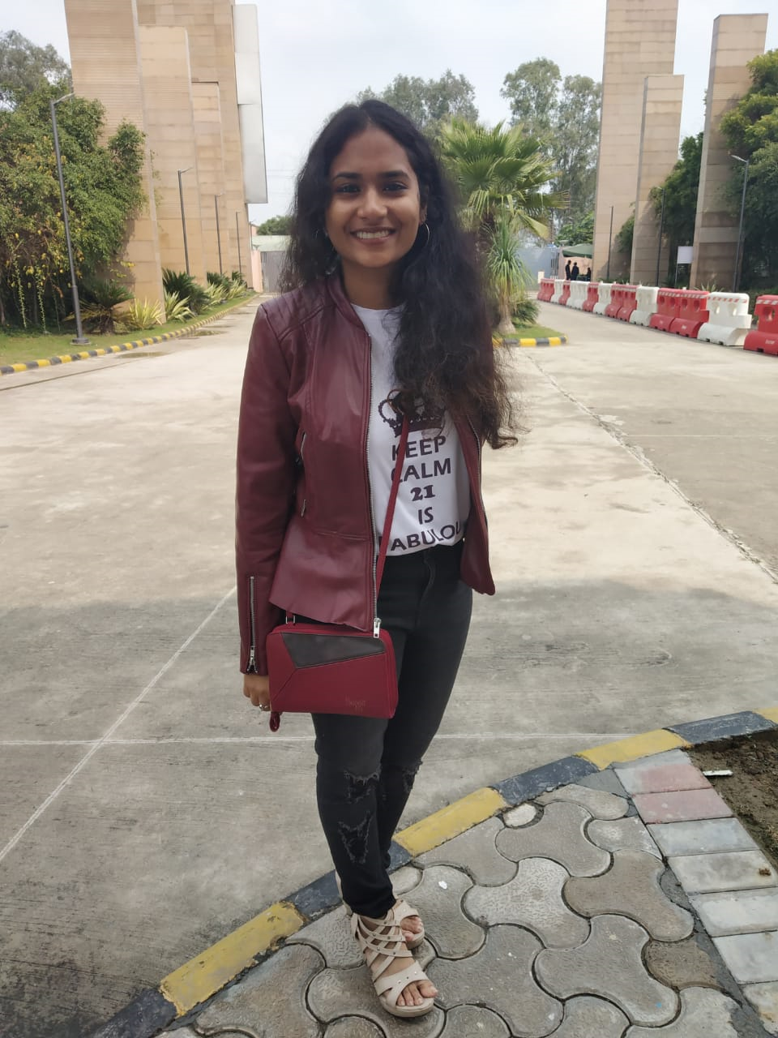
Our product #AMEXANALYTICS
GroupID: 5
Shiv Nadar University, Greater Noida
Aakriti Shukla
Mehar Bhatia
Ishita Jain
Manasi Mittal

Slide 3
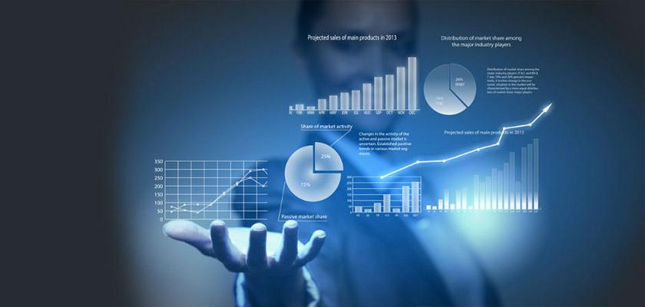
HELLO!
We are AMEX Analytics
And our job is to give you MORE MILLENNIALS

Slide 4
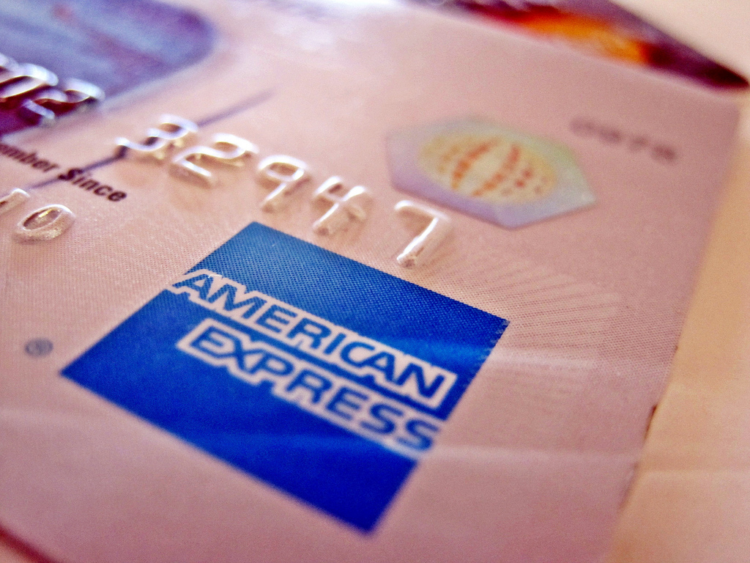
American Express
Amex, is an American multinational financial services corporation which is best known for its charge card, credit card and traveler’s cheque businesses. It is recognised for being “elite” and card has gathered prestige.
Recently A sizable jump in card purchase volumes coupled with improving net interest margins helped the card lending giant mitigate the impact of higher operating expenses as well as elevated card charge-off rates on its bottom line.

Slide 5
Understanding the Consumer
Who are the millennials and what do they want?

Slide 6

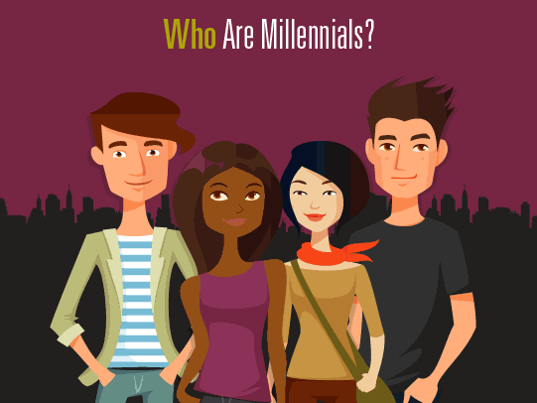
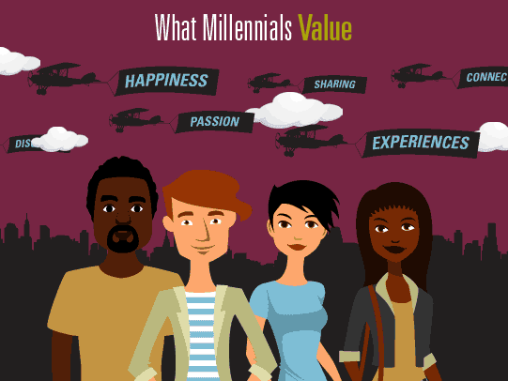

Slide 7
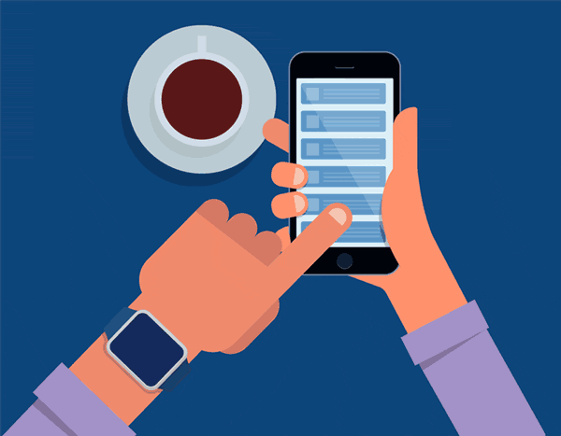
Millennials Look to their Network for answers
Gen Y is well-acquainted with the power of word of mouth.
They believe and often rely upon what their friends and family have to say.
If they are extremely happy or disappointed in some service or product, they want the company as well as their consumers to know.
“Eight out of 10 millennials never buy anything without first reading a review, a study has found.” - https://www.independent.co.uk

Slide 8
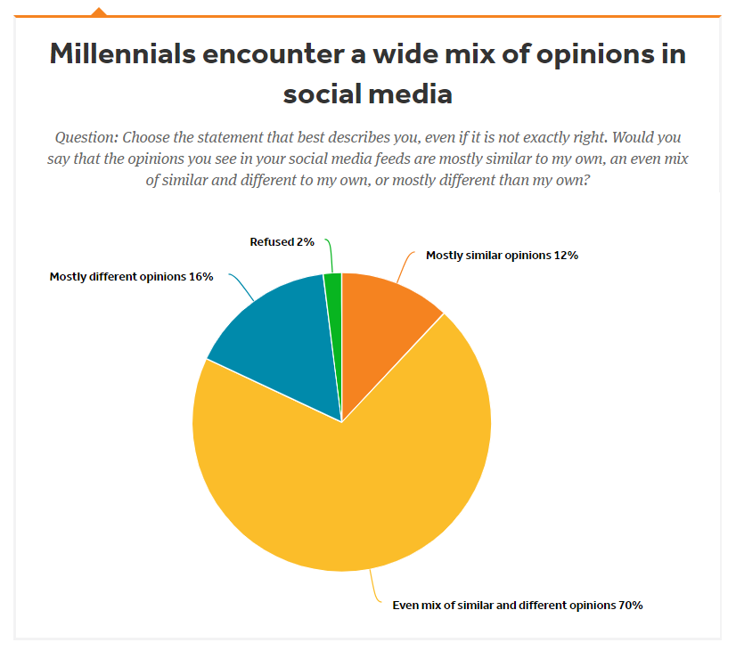
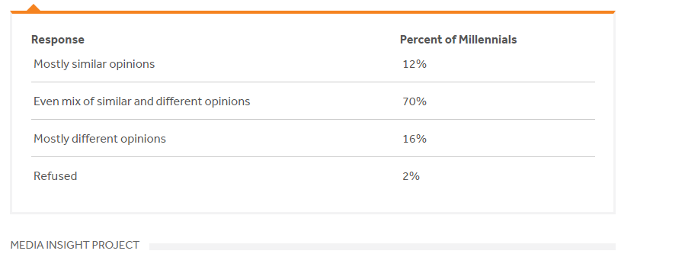

Slide 9
What do we have in Store?
Review Analysis
We wish to perform a rigorous segregation of reviews into being positive or negative by using selenium in order to scrape relevant tweets and consequently apply sentiment analysis to derive the overall opinion of the respective consumer.
How does it help?
We are able to extract the tweets in accordance to the input query, be it ‘visa’, ‘mastercard’, or ‘amex’.
By monitoring competitive company reviews, we can obtain the lot of satisfied/dissatisfied consumers and strategise.
The sentiment analysis model classifies the tweets as being positive/negative with an accuracy of 93%
Vulnerable Consumers: The consumers that have recently faced issues with competitor companies form a target consumer-base for us and the ones giving negative reviews about AMEX.

Slide 10
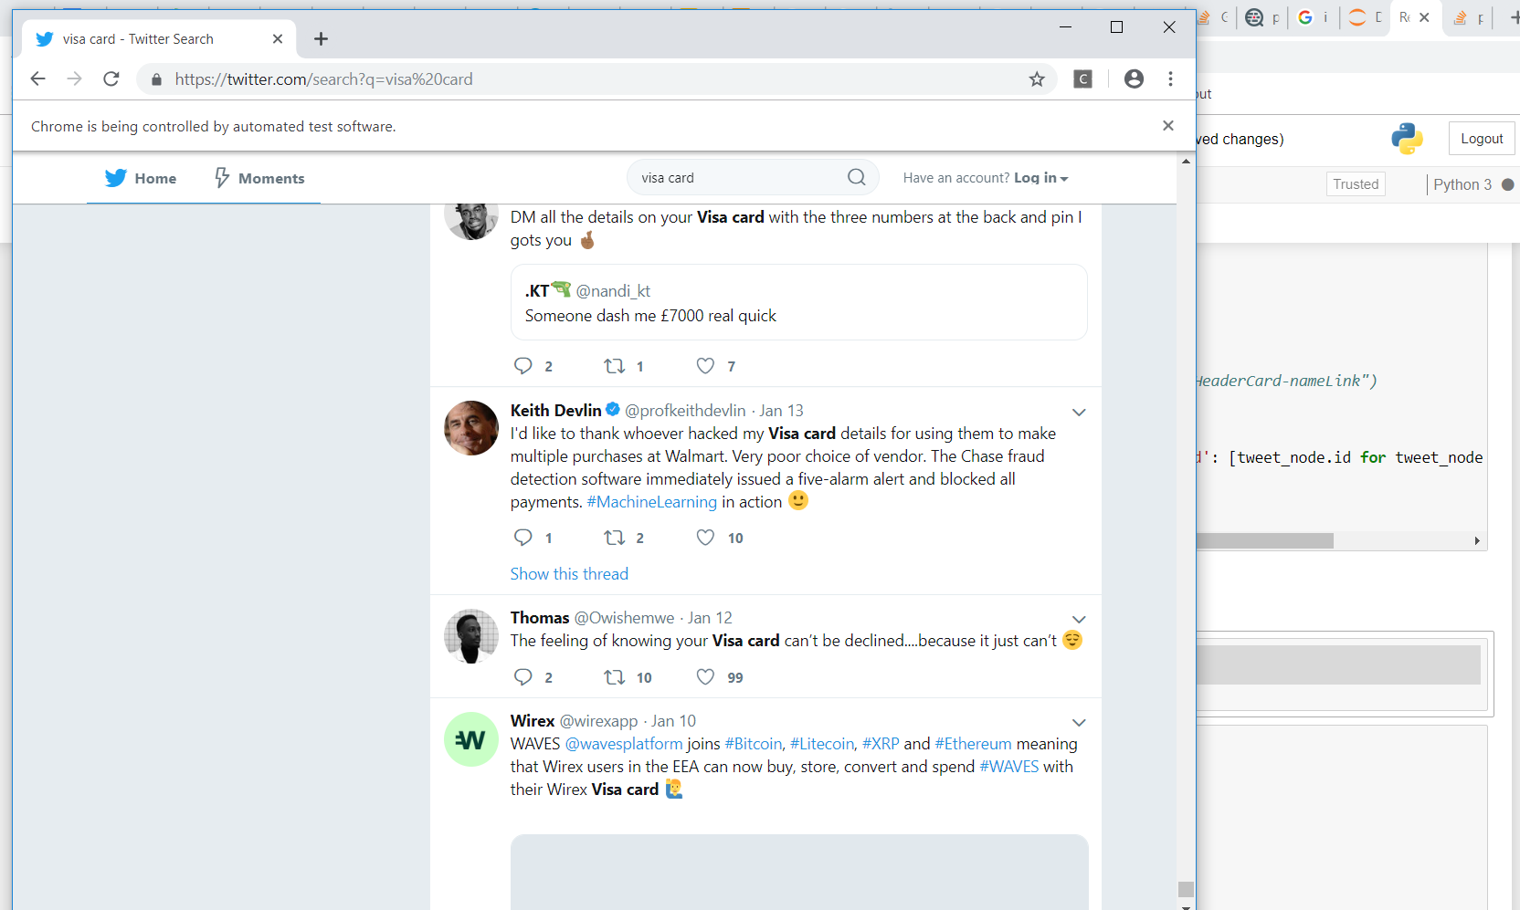
SCRAPE
We obtain the relevant tweets for the search query ‘visa card’, scrape the data and store it in a dataframe.
Place your screenshot here

Slide 11
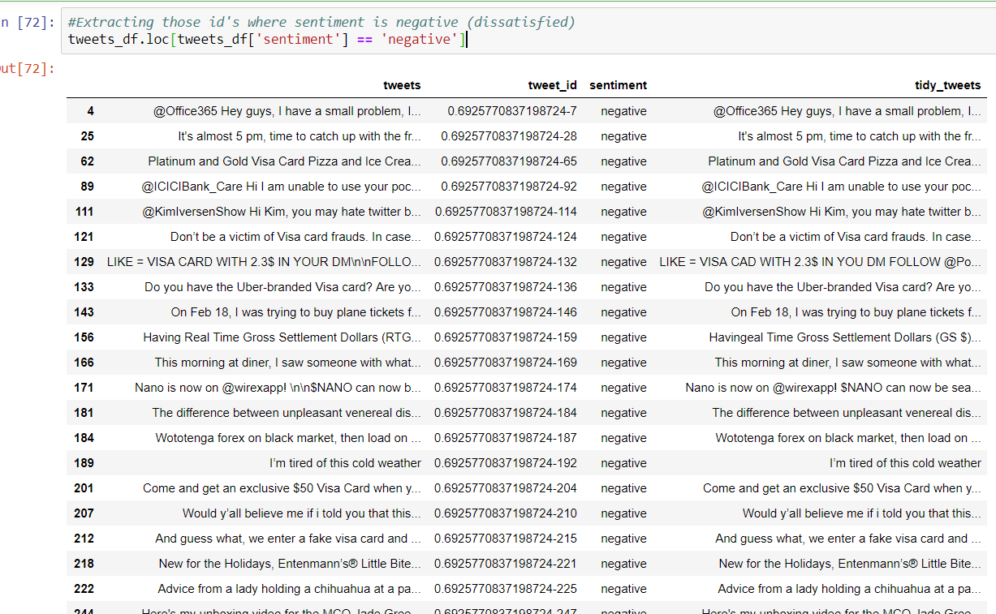
Relieve the dissatisfied
After performing sentiment analysis, we obtain a list of unhappy competitor company customers.
This technique can be extended to other platforms where we can find customer reviews!
Place your screenshot here

Slide 12
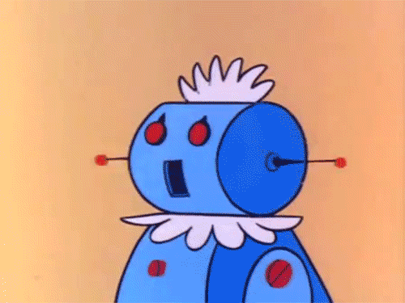
Millenials love to interact with Chatbots
Millenials value connection.
They’d rather be talking to a bot that responds to them than typing in queries and finding answers.
According to CARAVAN statistics, 60% of the millennials use chatbots 70% of those report positive experiences, and of the millennials who have not used them, more than half say they are interested in using them.
Millennials value speed and efficiency. Chatbot provides it all.

Slide 13

Our Supercool AMEX Bot
How does it help?
A master solution to all customer queries within seconds.
How can we use it to our benefit?
The chat history will help in monitoring potential customer behaviour.
What is the customer asking for? Is there anything that they need that we are not currently providing?
Also it will assist in identifying those sectors which customers value more.

Slide 14
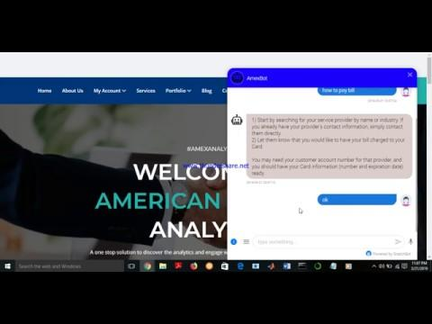

Slide 15
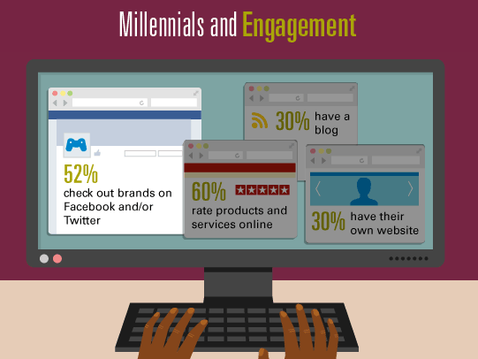
Millenials are all about Social Media
They value experiences.
GenY loves social media!
“88% of Millennials have a Facebook account, and over half of them use the platform regularly.” - www.laveh.com

Slide 16
Social Media Strategy?
A Campaign!
We propose to have a campaign called #ExpresswithAMEX where people share video testimonials of their credit card experience and avail benefits.
The carriers of the campaign would be “influencers”, customers identified through our database that have a high following (say, more than 1K) on social media platforms.
How does it help?
Automatically contact the “influencers” via email/instagram DMs/message to participate in the campaign and spread the word in return for points and rewards
After the campaign commences, it would be a possible to assign an influencer score to each participant in the campaign by looking at their outreach (a person reaching out to 100 people has a score of 0.1 and another that reaches out to 1000 would get a score of 1 or 100% outreach) and reward them benefits accordingly.

Slide 17
Millenials are focused on saving!
A 2018 Bank of America survey found that 1 in 6 millennials — which BoA defined as those between age 23 and 37 — now have $100,000 or more in savings.
That's impressive!
But that stat doesn't tell the whole story!
While some millennials are increasingly proving to be savvy savers, many other young people are not making progress at holding onto their cash.
Here are a few charts

Slide 18
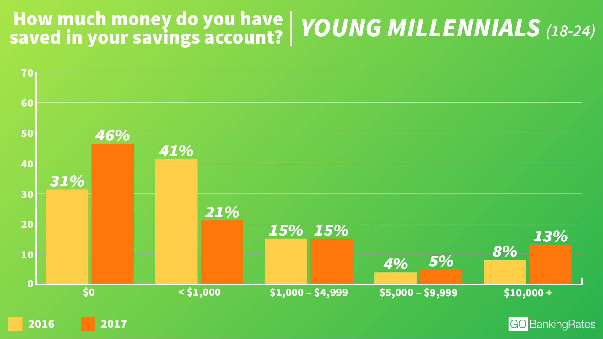
Source: https://www.cnbc.com/2018/02/09/a-growing-percentage-of-millennials-have-absolutely-nothing-saved.html

Slide 19
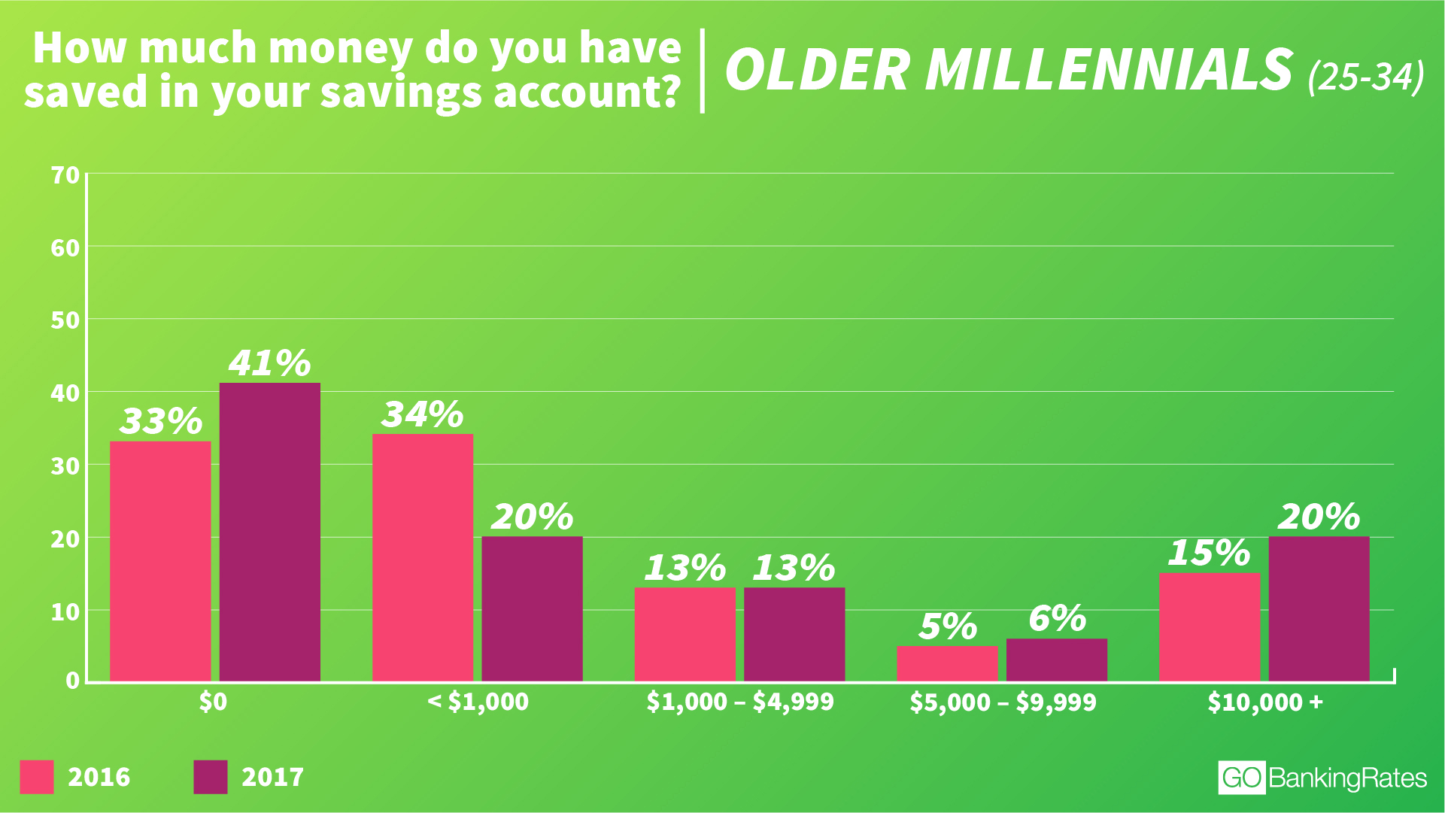
Source: https://www.cnbc.com/2018/02/09/a-growing-percentage-of-millennials-have-absolutely-nothing-saved.html

Slide 20

IDEA!
Personalized Wallet Management System
We felt the need to design a Personalized Wallet Management System for AMEX ANALYTICS website.
The AMEX card holder will be able to keep track of his/her payments.
The AMEX card holder can form a wallet where he/she can make sections for various purchases and assign budgets to them. This can also be edited too.
The customer can then assign budgets for each section.
After a payment has been using AMEX card, the amount/money will be subtracted automatically from the balance amount.

Slide 21
IDEA!
Personalized Wallet Management System
For example, the customer can form sections in the wallet like ‘House Rent’, ‘Restaurants’, ‘Electricity’, ‘Clothing’ etc.
After a payment has been done using AMEX card, the amount/money will be subtracted automatically from the balance amount.
For example, say a customer has assigned Rs: 5000 to clothing for a month. After a transaction of Rs 1500 at H&M, the amount will be deducted automatically from the balance amount.
In the next slides, we present the screenshots from the prototype of the personalised wallet management system.

Slide 22
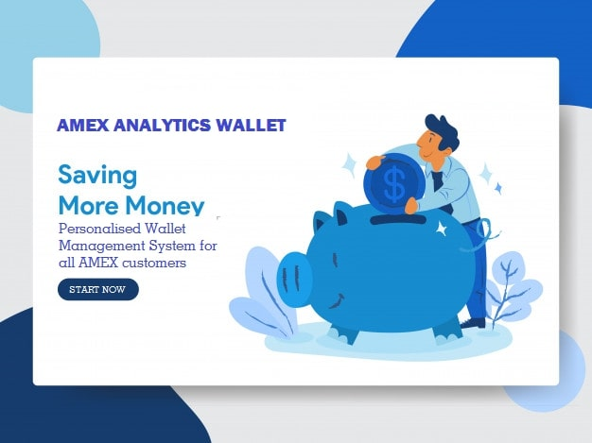

Slide 23
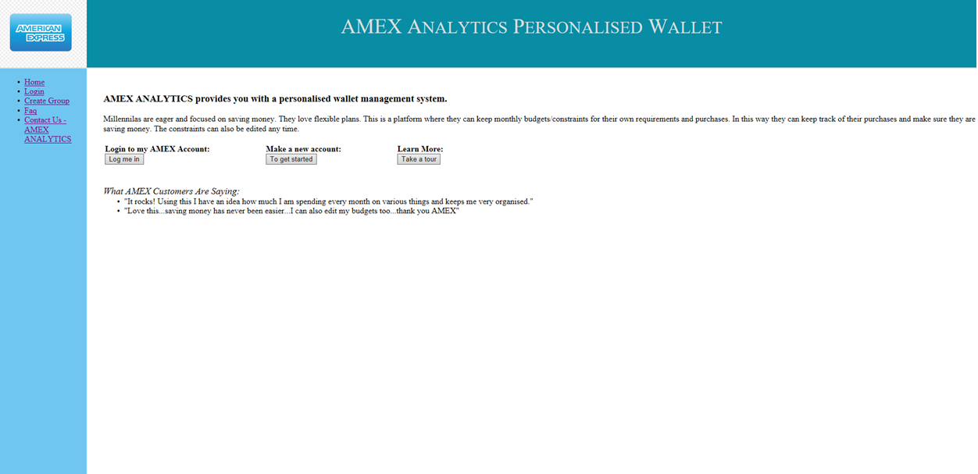

Slide 24
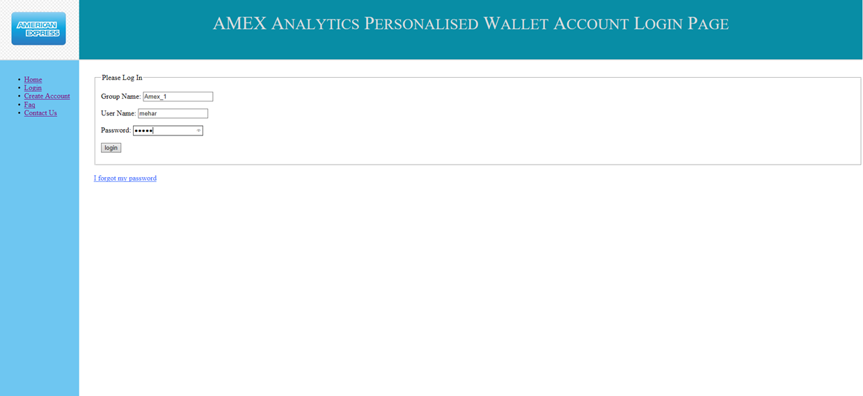

Slide 25
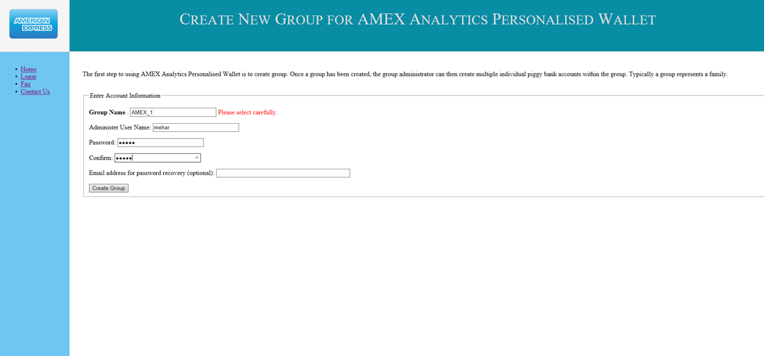

Slide 26
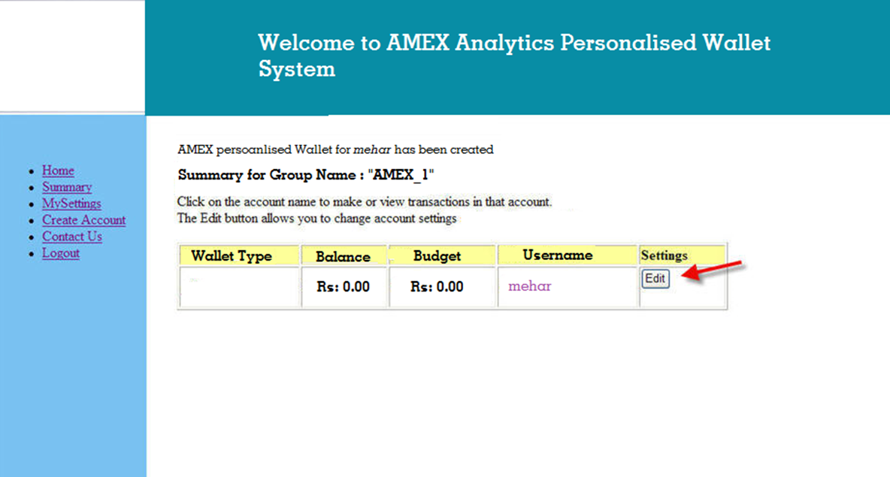

Slide 27
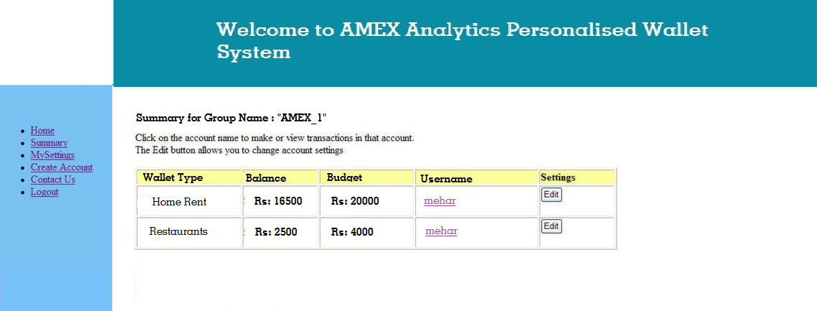

Slide 28
Continuing the Good Work
RETENTION OF CUSTOMERS BY KNOWING THEIR LIKES:
Social networks are an extraordinarily important part of Millennials’ digital lives, in part because social networks have become much more than a way to connect about personal matters.Social media engages them with different opinion and views.
We have tried to analyse what #amexcard users likings by extracting the positive keywords from their tweets including both positive and negative reviews.
APPROACH:
Scraping the data from social media like twitter and analysing them for positive keywords along with their frequency.
Analysing the satisfaction content of a particular feature among the users by measuring its frequency in our list of keywords.

Slide 29
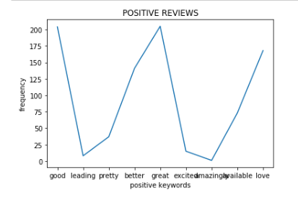
THE PLAN? Keep them happy!
INCREASE CUSTOMER BASE WHILE RETAINING THE PREVIOUS CUSTOMERS:
Try not to change the features which makes the customers happy. The graph shows the satisfaction metric of most commonly used positive keywords.

Slide 30
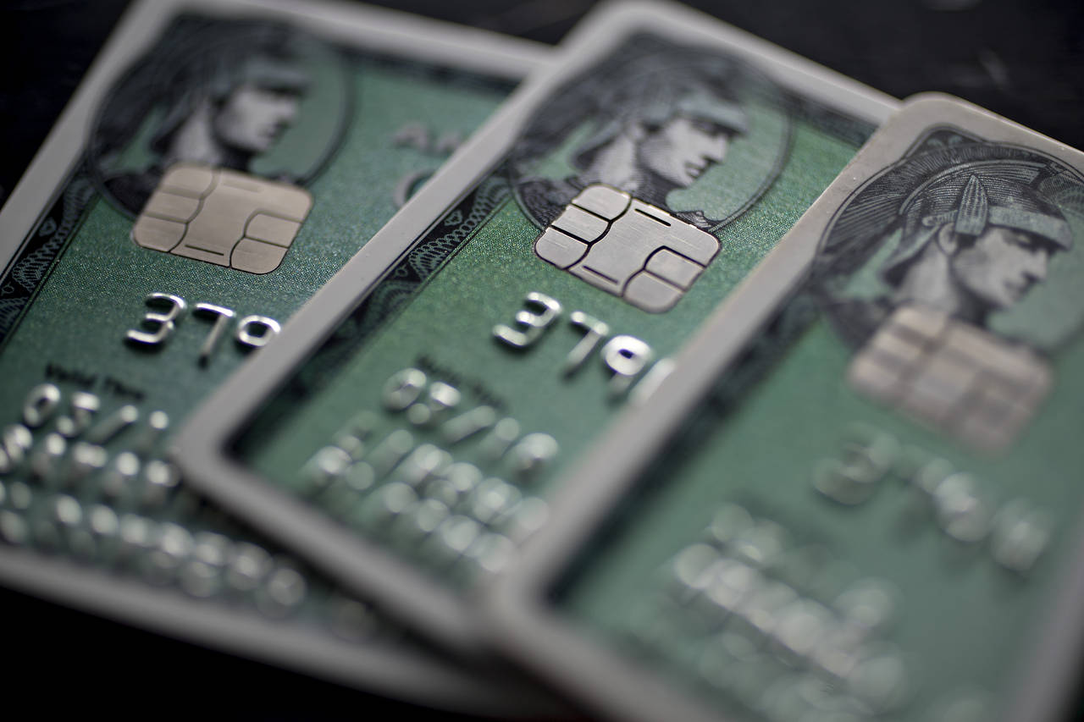
You don’t wanna lose them! Do you?
The New York Times pointed out that in 2016 the number of Amex cards in use fell 18 percent, while Amex revenue in 2016 was down more than $2 billion from two years earlier.
It is important to catch a hold of those customers who are on the verge of switching or withdrawing from AmEX services. Also, why are they doing so?

Slide 31
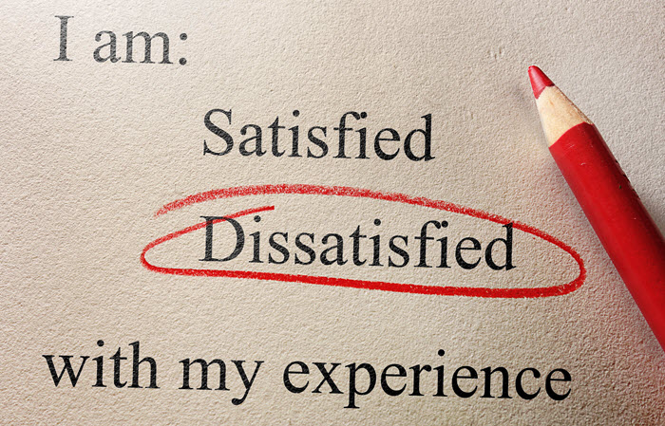
Make them Stay
We aim to acquire data regarding customers who have been disappointed in the services of the company.
Like we did for competitor companies, it’s important to recognise the points of dismay with AmEX’s products and services.
We did this by scraping tweets for the query ‘amex’ as displayed in the following slide and successively applying sentiment analysis to categorise them as positive/negative.

Slide 32
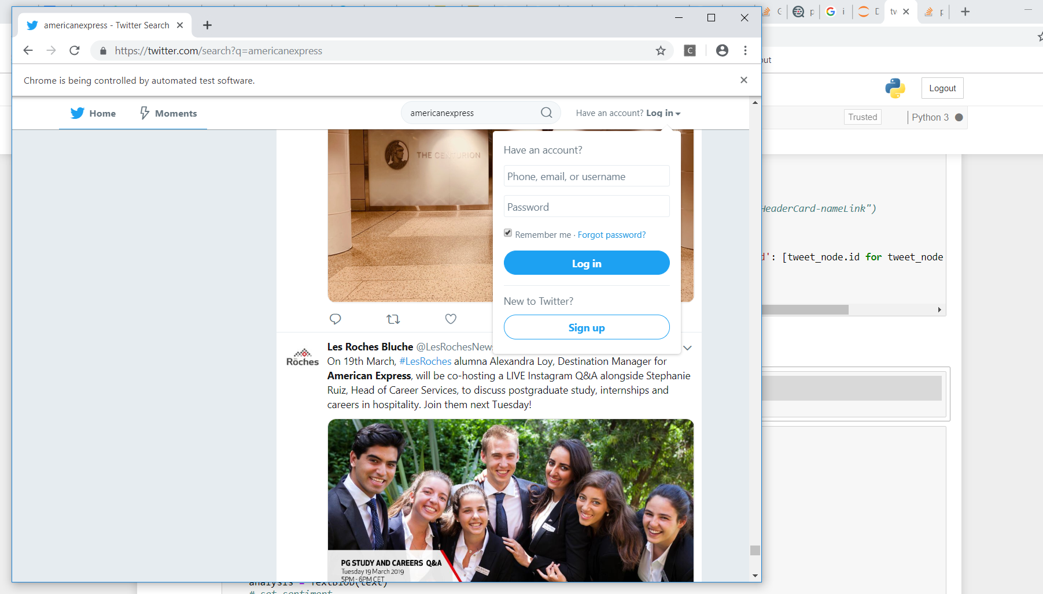
SCRAPE
Query: ‘americanexpress’
scrape the data and store it in a dataframe.
Place your screenshot here

Slide 33
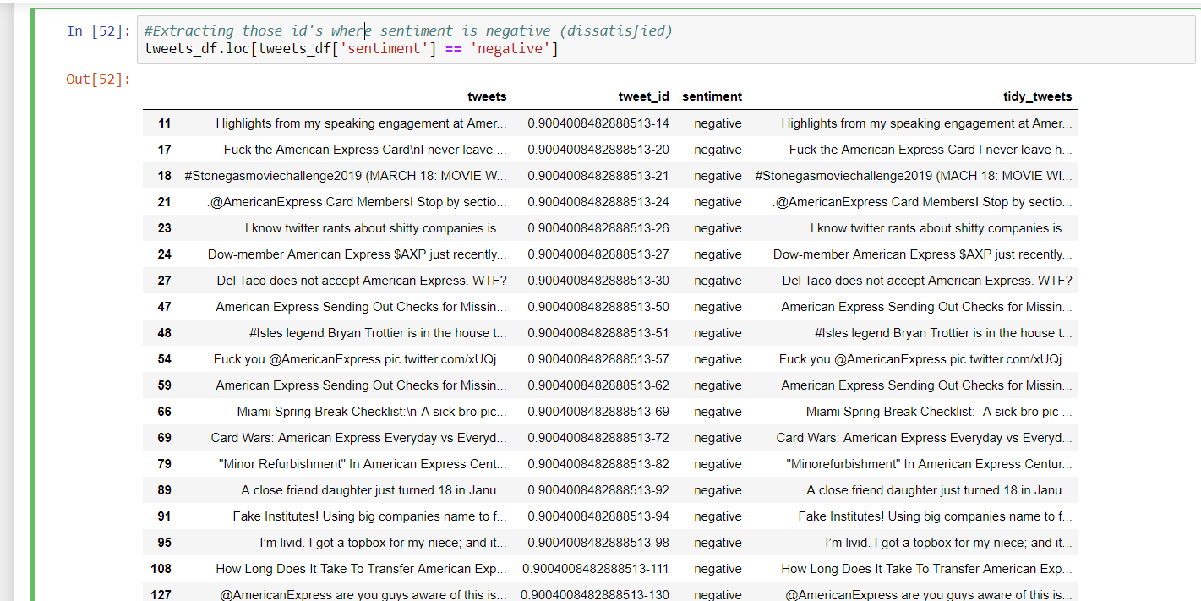
Don’t let them go
After performing sentiment analysis and segregation, we obtain a list of unhappy customers likely to leave. Address their grievances and concerns.
Place your screenshot here

Slide 34

Reality is an Illusion. We have the perfect illusionary reality for our premium customers!
Millenials love cool tech.
Infact, they are one of the most tech-savvy generations.
We have a techie way to engage this techie generation.
Business Cards equipped with augmented reality (AR) that showcase the cardholder’s direct links to website, linkedin profile, etc will be given to our Gold members at a minimal cost.
The best customers will be able to acquire this card for FREE!
Watch the video on the following slide to know more.

Slide 35
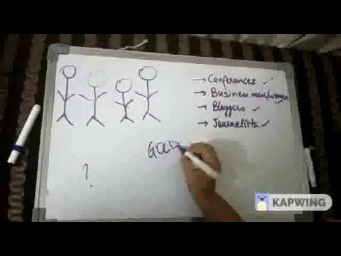
AR BUSINESS CARDS

Slide 36
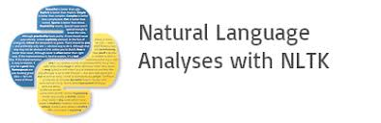








Technology Stack

Slide 37
To Sum it Up
All in all, we have provided technical solutions to attract , engage and make sure that millennials stick by utilizing the distinguishing characteristics of the Gen Y.

Slide 38

Thank You for your time!
We hope you enjoyed our ideas as much as we enjoyed creating them! :)

